Slide 1
DCSA Foreign Travel Briefing
UNCLASSIFIED
Non-Country Specific
This presentation contains information associated with United States Persons (USPER) as defined by Executive Order 12333 and Department of Defense Manual 5240.01. Such information should be handled and protected in accordance with applicable Intelligence Oversight rules by persons and organizations subject to those rules. Defense Counterintelligence and Security Agency (DCSA) collects, retains, and disseminates USPER Information (USPI) in accordance with all applicable laws, directives, and policies. Questions about the handling of this information should be referred to DCSA (Region) Region Counterintelligence (CI).
Don Selvy Enterprises, Inc
DCSA-CI-23-005

Slide 2
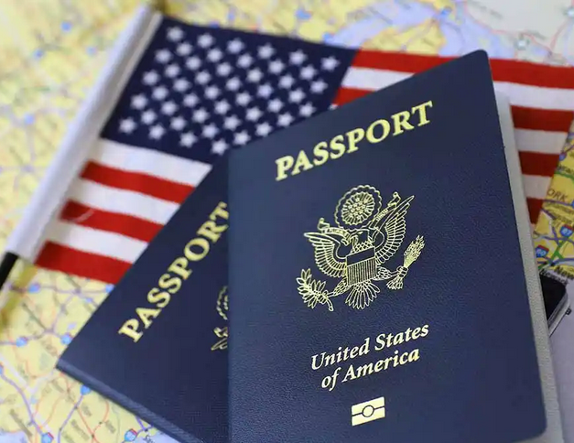
Agenda
UNCLASSIFIED
Foreign Intelligence Entities
Vulnerability Awareness
Elicitation
Countering Elicitation
Local Laws
Crime, Arrest, and Detention
Information Security
Personal Safety
Travel Destination
Before you go
Reporting Requirements

Slide 3
Foreign Intelligence Entities
UNCLASSIFIED
Foreign Intelligence Entities (FIE):
Known or suspected foreign state or non-state organizations or persons that conduct intelligence activities to acquire U.S. information, block or impair U.S. intelligence collection, influence U.S. policy, or disrupt U.S. systems and programs
Industrial Espionage
Industrial espionage is the acquisition of trade secrets from business competitors
FIE use industrial espionage to accelerate their research and development programs

Slide 4
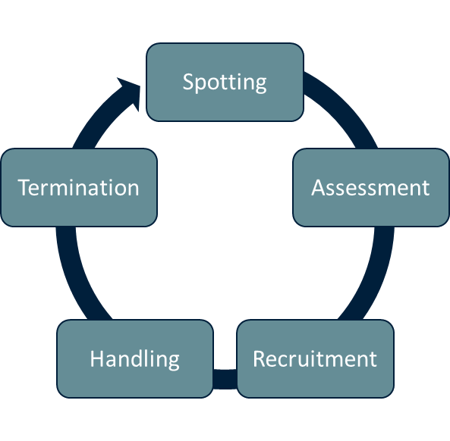
Foreign Intelligence Entities (Cont.)
UNCLASSIFIED
Foreign Intelligence: The Recruitment Cycle
Spotting: Stage of identifying potential intelligence targets
Assessment: Learning as much as possible about the target
Recruitment: Engaging the target, using a motivator such as money, ideology, blackmail, or ego
Handling: Recruited target begins to provide sensitive or classified information
Termination: Espionage activities come to an end

Slide 5
Vulnerability and Threat Awareness
UNCLASSIFIED
Foreign Travel
Your risk of being a target of FIE is greater when you travel overseas
Be aware:
FIE have better access to you
FIE are not restricted by U.S. Laws
You are subject to local laws
Your personal devices transmit and store your personal information
You are the first line of defense in protecting classified information and defense technologies!

Slide 6
Vulnerability and Threat Awareness (Cont.)
UNCLASSIFIED
What You Know, Can Make You a Target!
Cleared contractors provide critical research and support to programs giving the United States an economic, technological, and military advantage
You have access to information that may be sought after by FIE, including:
Research, development, testing, and evaluation
Program milestones and specifications
Personnel (HR), logistics, facilities
System capabilities, security, and operations

Slide 7
Elicitation
UNCLASSIFIED
Definition:
The acquisition of information from a person or group in a manner that does not disclose the intent of the interview or conversation
Methods:
Guided conversation
Quid Pro Quo
Flattery
Provocative statements

Slide 8
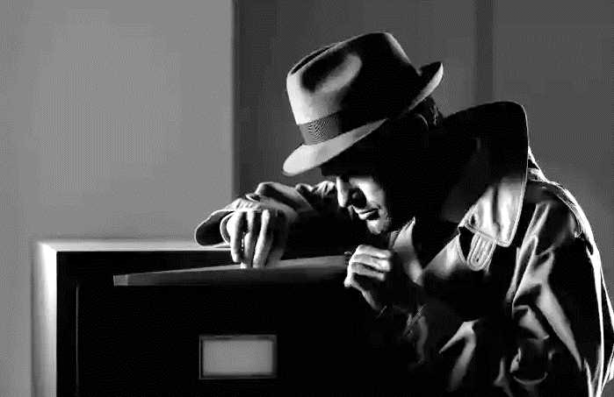
Elicitation
UNCLASSIFIED
Techniques that can be used to collect your information
Cyber
Email Intercepts
Tracking activity via ATM transactions and Internet usage at Internet kiosks and Wi-Fi access points
Unauthorized access to or theft of electronic devices and installation of malicious software at customs or hotel
Personal or Impersonal
Recording of telephone conversations
Hotel room and safe intrusions
Enhanced interviews by customs officials
Surveillance: Bugged hotel rooms or airline cabins

Slide 9
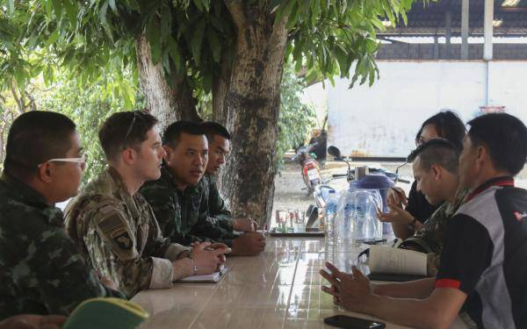
Elicitation (Cont.)
UNCLASSIFIED
Techniques (cont.):
“Honeypot traps”
In espionage terminology, honeypot and honey trap are terms for an operational practice involving
the use of a covert agent (usually female), to create a sexual or romantic relationship to compromise
a (usually male) target.
Suspicious approaches at public forums/events
Requests to transport items outside of the country
Exploiting criminal activities
Suspicious questioning by translators, guides, and taxi drivers

Slide 10
Elicitation (Cont.)
UNCLASSIFIED
Examples?
Requests for protected information under the guise of a price quote or purchase request, market survey, or other pretense
Foreign entities targeting personnel traveling overseas via airport screening or hotel room incursions
Attempts to entice personnel into situations that could lead to blackmail or extortion
Attempts by foreign customers to gain access to hardware and information that exceeds the limitations of the export licenses on file
Attempts to place personnel under obligation through special treatment, favors, gifts, or money

Slide 11
Countering Elicitation
UNCLASSIFIED
The most successful elicitation occurs when the target is alone.
Know what information is essential
Know what you are allowed to say
Work in pairs
Feign ignorance
Change the subject
Be direct
Deflect, ignore, question
Be boring
Provide generalized answers
Challenge the question
Notes:
(More next p

Slide 12
Countering Elicitation (Cont.)
UNCLASSIFIED
What to do if approached?
Be observant of the person questioning you
Maintain professional composure
Remain non-committal and avoid clearly expressing your opinions or intentions
REPORT: Provide as much information as possible to your security point of contact upon return to the United States!
Do not discuss with colleagues!
Report when you return to the United States!

Slide 13
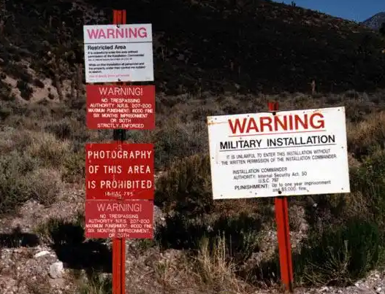
Local Laws
UNCLASSIFIED
While traveling, you are subject to the local laws
Do not make assumptions about what is acceptable
When traveling abroad:
Be aware of local laws and cultural expectations
Some countries forbid photography of government facilities and religious sites
Do not take photographs in the vicinity of foreign military bases, buildings, or personnel

Slide 14
Crime, Arrest, and Detention
UNCLASSIFIED
Crime is one of the biggest threats facing travelers
Crimes against travelers are often crimes of opportunity
Follow these steps to protect yourself:
Stay alert and exercise good judgment
When possible, ensure your hotel room has a peephole and a deadbolt lock or a chain-and-slide bolt
If you see an accident, don't stop; instead, call for help from a safe area
Minimize the amount of cash you carry
Be wary of street vendors and innocent-looking youngsters as they may be decoys for pick pockets

Slide 15
Crime, Arrest, and Detention (Cont.)
UNCLASSIFIED
Foreign police and intelligence agencies detain persons for many reasons, including simple curiosity
If you are detained or arrested for any reason:
Exercise good judgment and be professional in your demeanor
Stay calm, maintain your dignity, and do not do anything to provoke the arresting officer
Ask to contact the U.S. Embassy or Consulate
Do not admit to anything or volunteer any information
Do not sign anything until the document is examined by an attorney or an embassy/consulate representative
Request identification from embassy/consulate representatives

Slide 16
Information Security
UNCLASSIFIED
Before you travel:
Leave electronic equipment you do not need at home
If you take it, take proactive steps to secure your devices and your personally identifiable information (PII), i.e. your name, address, date of birth and Social Security Number
Back up your electronic files
Remove sensitive data
Install strong passwords
Confirm antivirus software is up-to-date
Take designated, sanitized “travel laptops”

Slide 17
Information Security (Cont.)
UNCLASSIFIED
While Traveling:
Be vigilant about your surroundings:
Keep your devices secure in public places such as airports, hotels, and restaurants
Cover your screen: especially when entering passwords, pins, and accessing sensitive information
Consider using a privacy screen on your laptop
Be cautious while using public Wi-Fi:
Beware of data thieves trying to capture passwords to compromise your PII or access your accounts
Public Wi-Fi includes internet cafes, coffee shops, bookstores, travel agencies, clinics, libraries, airports and hotels

Slide 18
Information Security (Cont.)
UNCLASSIFIED
Countermeasures: (Can decrease or prevent loss of PII)
Do not use the same passwords or PINs while traveling
Do not use the public Wi-Fi to make online purchases or access bank accounts and other sensitive information
While using a pubic Wi-Fi, periodically disconnect from the network, then log back in again
Avoid using public equipment for sensitive communications, i.e. phones, computers and fax machines
Never use public USB charging stations to charge your phone, only use AC power outlets
Perform a comprehensive anti-virus scan on all electronic devices

Slide 19
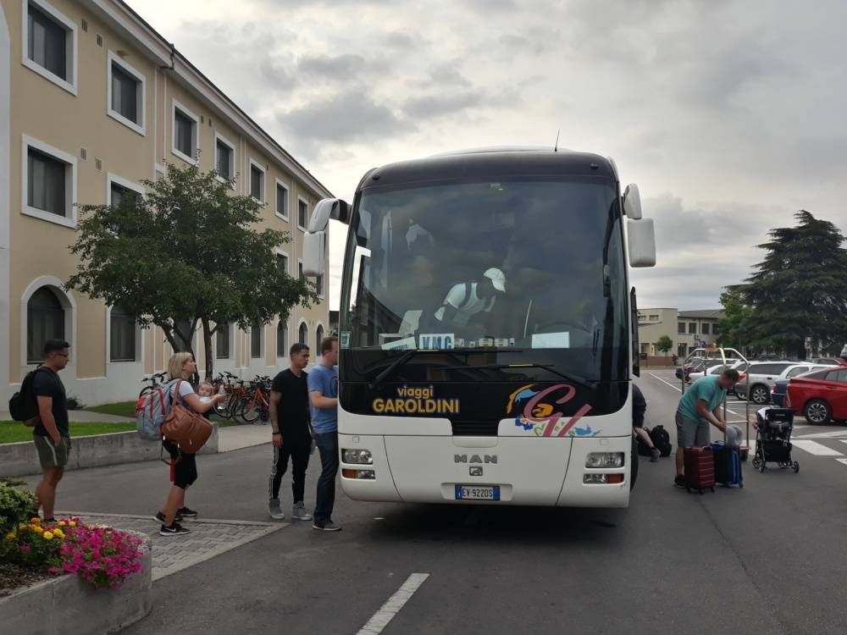
Personal Safety
UNCLASSIFIED
New surroundings and exotic destinations may distract you
Maintain a Low Profile
Do not make reference to your government related duties or access to classified information
Do not publicize “post” travel plans
Exchange money into the local currency
If possible, keep your wallet in your front pocket and do not carry a handbag
If you must carry a backpack, zipper locks are recommended
Drive an inconspicuous vehicle and vary where you park

Slide 20
Personal Safety (Cont.)
UNCLASSIFIED
Hotel Safety Tips
Only patronize reputable hotels
Note escape routes, secure doors, and keep windows locked
Do not accept deliveries unless previously arranged
Do not use the hotel phone to discuss travel plans
Do not leave your room key at the front desk. Keep it with you at all times
Do not stay in hotel rooms that are located on the first floor or easily accessible from the outside

Slide 21
Personal Safety (Cont.)
UNCLASSIFIED
Travel Safety Tips
Always remain alert and maintain a cautious attitude
Conceal material wealth and dress like the locals
Avoid isolated roads, danger areas, civil disturbances, and large crowds
Learn what parts of town locals consider risky and avoid them
Whenever possible, travel in groups
Avoid using unmarked taxis:
If someone approaches you with a taxi outside of the normal taxi stand, politely decline the offer
Keep valuables on your person, not in the trunk

Slide 22
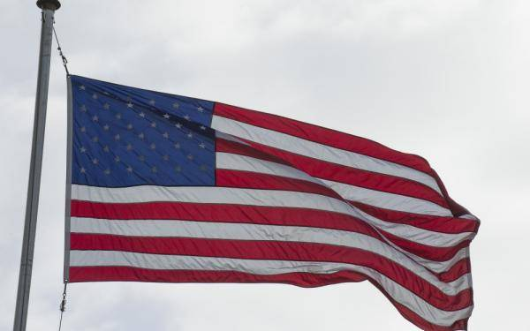
Before You Go
UNCLASSIFIED
Enroll in the U.S. Department of State’s (DOS) Smart Traveler Enrollment Program (STEP)
Thoroughly review DOS travel advisories: https://travel.state.gov/content/travel/en/traveladvisories/traveladvisories.html/ for your destination, including:
Travel Advisory Level
Embassy Messages and contact information
VISA requirements
Safety and Security (Crime and Terrorist Threats)
Laws
Health, and COVID restrictions: https://travel.state.gov/content/travel/en/traveladvisories/COVID-19-Country-Specific-Information.html

Slide 23
Once You’ve Returned
UNCLASSIFIED
Contact your local security official for a Foreign Travel Debriefing upon return from your trip
Report any suspicious activity to your local security official
Additional Resources:
DCSA Center For Development of Security Excellence (CDSE) resources: https://www.cdse.edu/Training/Toolkits/Counterintelligence-Awareness-Toolkit/
Foreign Travel & Visits Best Practices
DCSA brochure “Preparing for Foreign Visitors”
Sample Technology Control Plan
Traveling and Espionage
Traveling with Mobile Devices

Slide 24
Questions?
UNCLASSIFIED
Contact Information:
Pamela Selvy/Don Selvy
AFSO/FSO
Cell: (410) 808-3510/ (410) 808-3510 E-mail:pselvy@dse-inc.net

